Slide 1
Cohen Sutherland line clipping algorithm
​

Slide 2


Agenda
A
Introduction
Objectives
Algorithm
Advantages and Disadvantages
Applications

Slide 3
Introduction
The Cohen-Sutherland line clipping algorithm is a fundamental technique used in computer graphics to efficiently determine which portions of a line segment lie within a specified rectangular clipping window. Developed by Ivan Sutherland and Danny Cohen in 1967, this algorithm revolutionized the field of computer graphics by enabling efficient rendering of complex scenes.

Slide 4
Objectives
The primary objective of the Cohen-Sutherland algorithm is to quickly identify line segments that are either completely outside, partially inside, or entirely inside a rectangular clipping region. By efficiently discarding line segments that are entirely outside the region, the algorithm reduces the computational burden associated with rendering only the visible portions of lines.

Slide 5
In the algorithm, first of all, it is detected whether line lies inside the screen or it is outside the screen. All lines come under any one of the following categories:
Visible
Not Visible
Clipping Case
1. Visible: If a line lies within the window, i.e., both endpoints of the line lies within the window. A line is visible and will be displayed as it is.
2. Not Visible: If a line lies outside the window it will be invisible and rejected. Such lines will not display.
3. Clipping Case: If the line is neither visible case nor invisible case. It is considered to be clipped case. First of all, the category of a line is found based on nine regions given below. All nine regions are assigned codes. Each code is of 4 bits. If both endpoints of the line have end bits zero, then the line is considered to be visible.

Slide 6
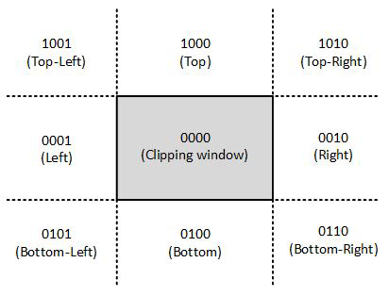
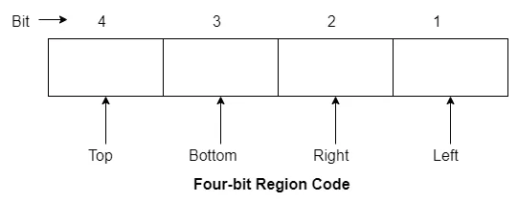
In this algorithm, we are given 9 regions on the screen. Out of which one region is of the window and the rest 8 regions are around it given by 4 digit binary.
The central part is the viewing region or window, all the lines which lie within this region are completely visible. A region code is always assigned to the endpoints of the given line.

Slide 7
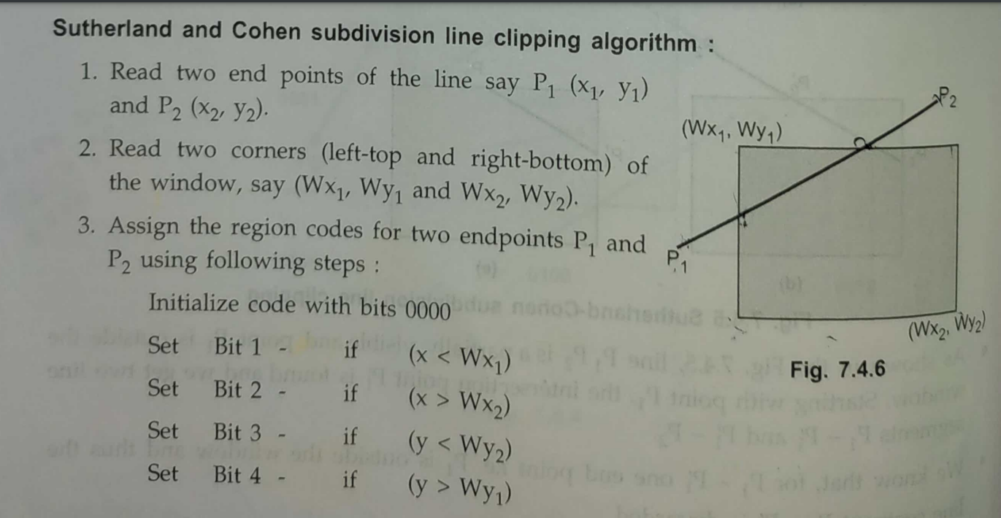
ALGORITHM:

Slide 8
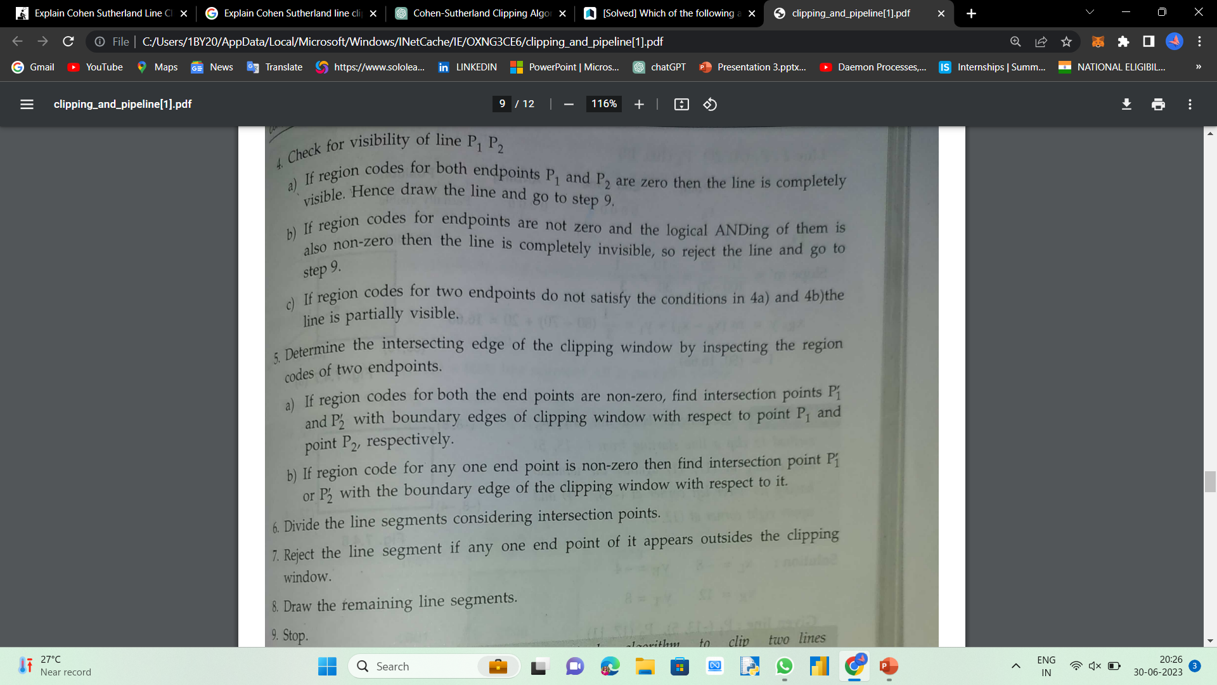

Slide 9
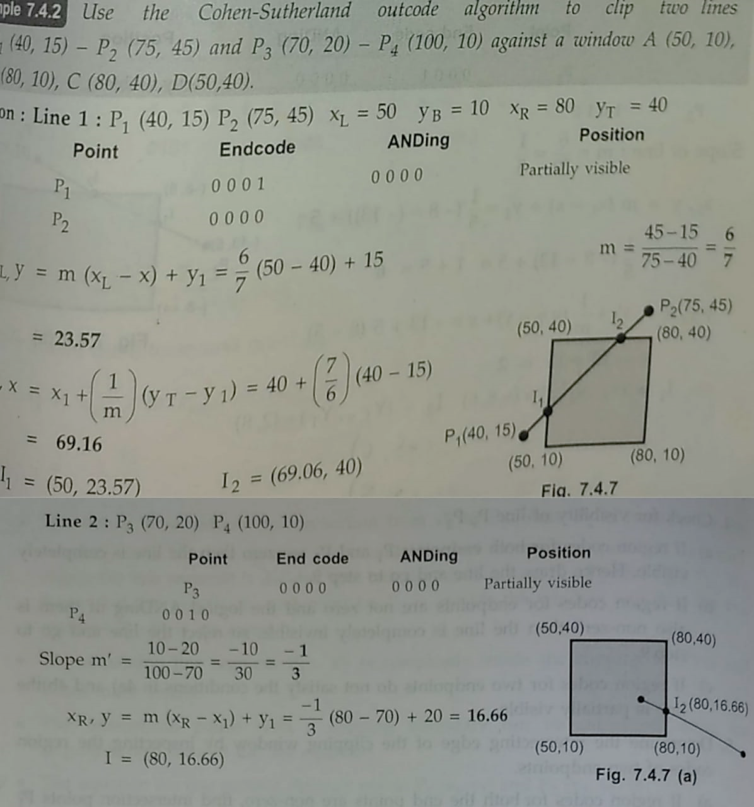

Slide 10
Advantages and disadvantages
Advantages
It is simple to learn and apply.
It is best suited for lines that are totally inside or outside.
It can easily be extended for 3D line clipping.
Disadvantages
Clipping is costly when done repeatedly.
This only applies to rectangular clipping windows.
It is incapable of handling any other shape.

Slide 11
Applications
Rendering: Efficiently determining which parts of line segments should be rendered, optimizing rendering performance.
Clipping in 2D graphics: Precisely defining the visible portions of line segments within a specified region or viewport.
Windowing systems: Managing windows and graphical elements within defined areas in graphical user interfaces (GUIs).
Augmented Reality (AR) and Virtual Reality (VR): Determining visible parts of virtual objects for immersive user experiences.

Slide 12
Sutherland-Hodgman polygon clipping algorithm

Slide 13
Introduction
The Sutherland-Hodgman polygon clipping algorithm is a widely used technique in computer graphics for clipping polygons against a convex clipping window. Developed by Ivan Sutherland and Gary Hodgman in 1974, this algorithm allows for the extraction of visible portions of a polygon within a specified region, enabling efficient rendering of complex scenes.

Slide 14
Objectives
The main objective of the Sutherland-Hodgman algorithm is to identify the intersection points between the polygon edges and the boundaries of the clipping window. By iteratively clipping each edge of the polygon against the window boundaries, it creates a new polygon that represents the visible portion of the original polygon

Slide 15
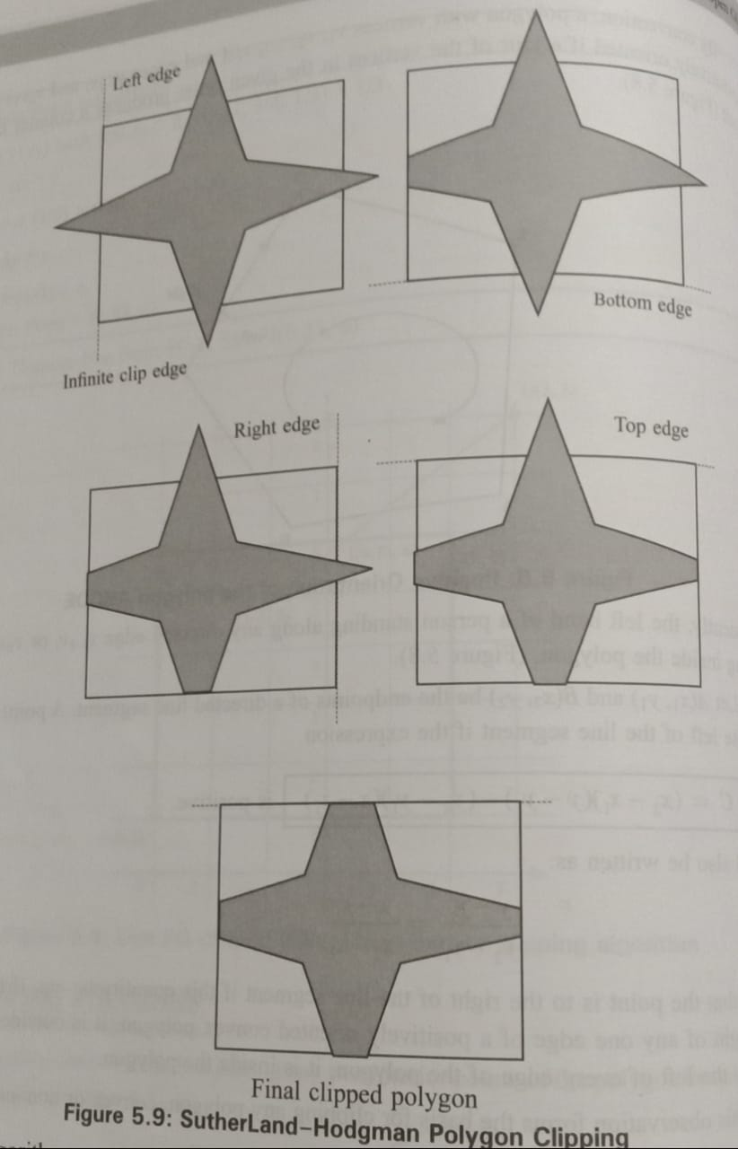

Slide 16
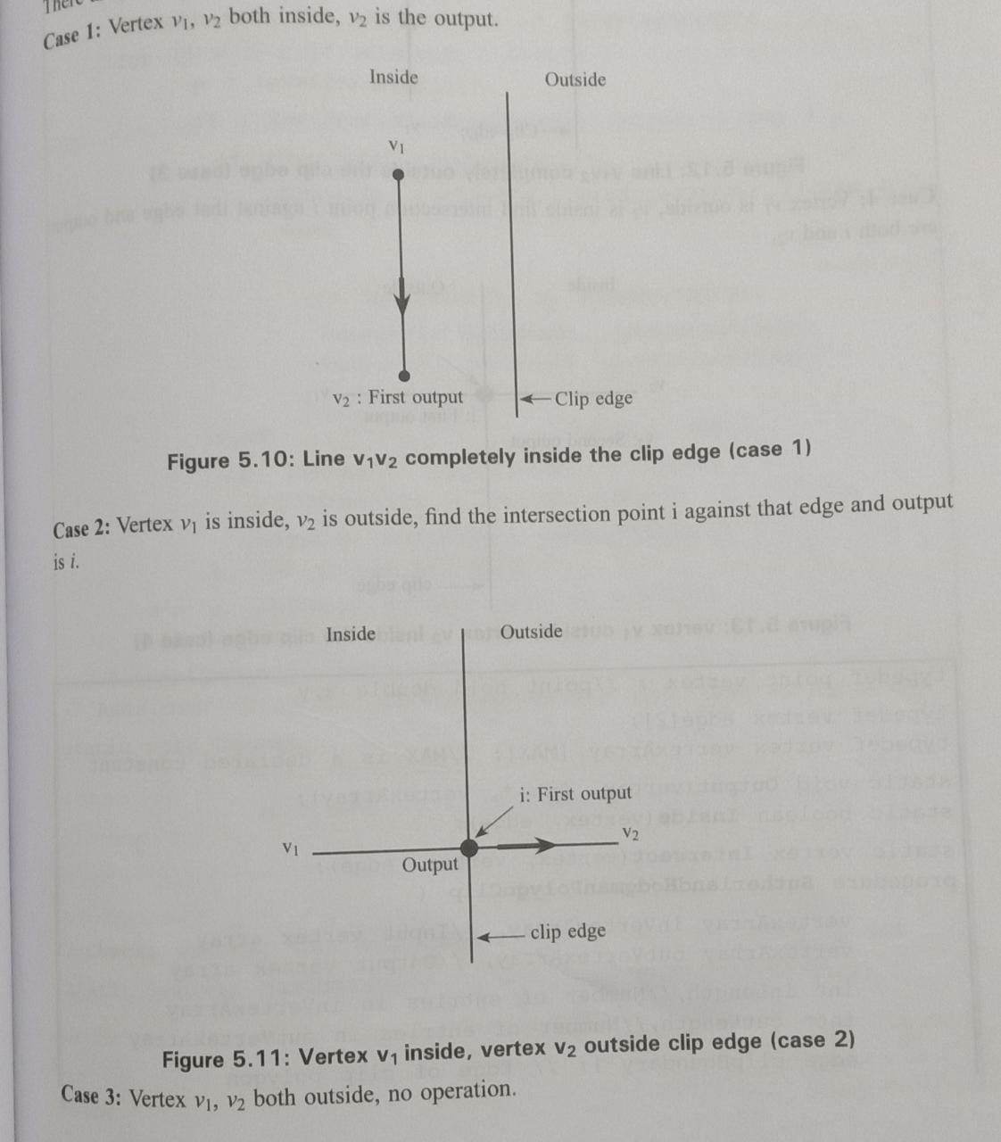

Slide 17
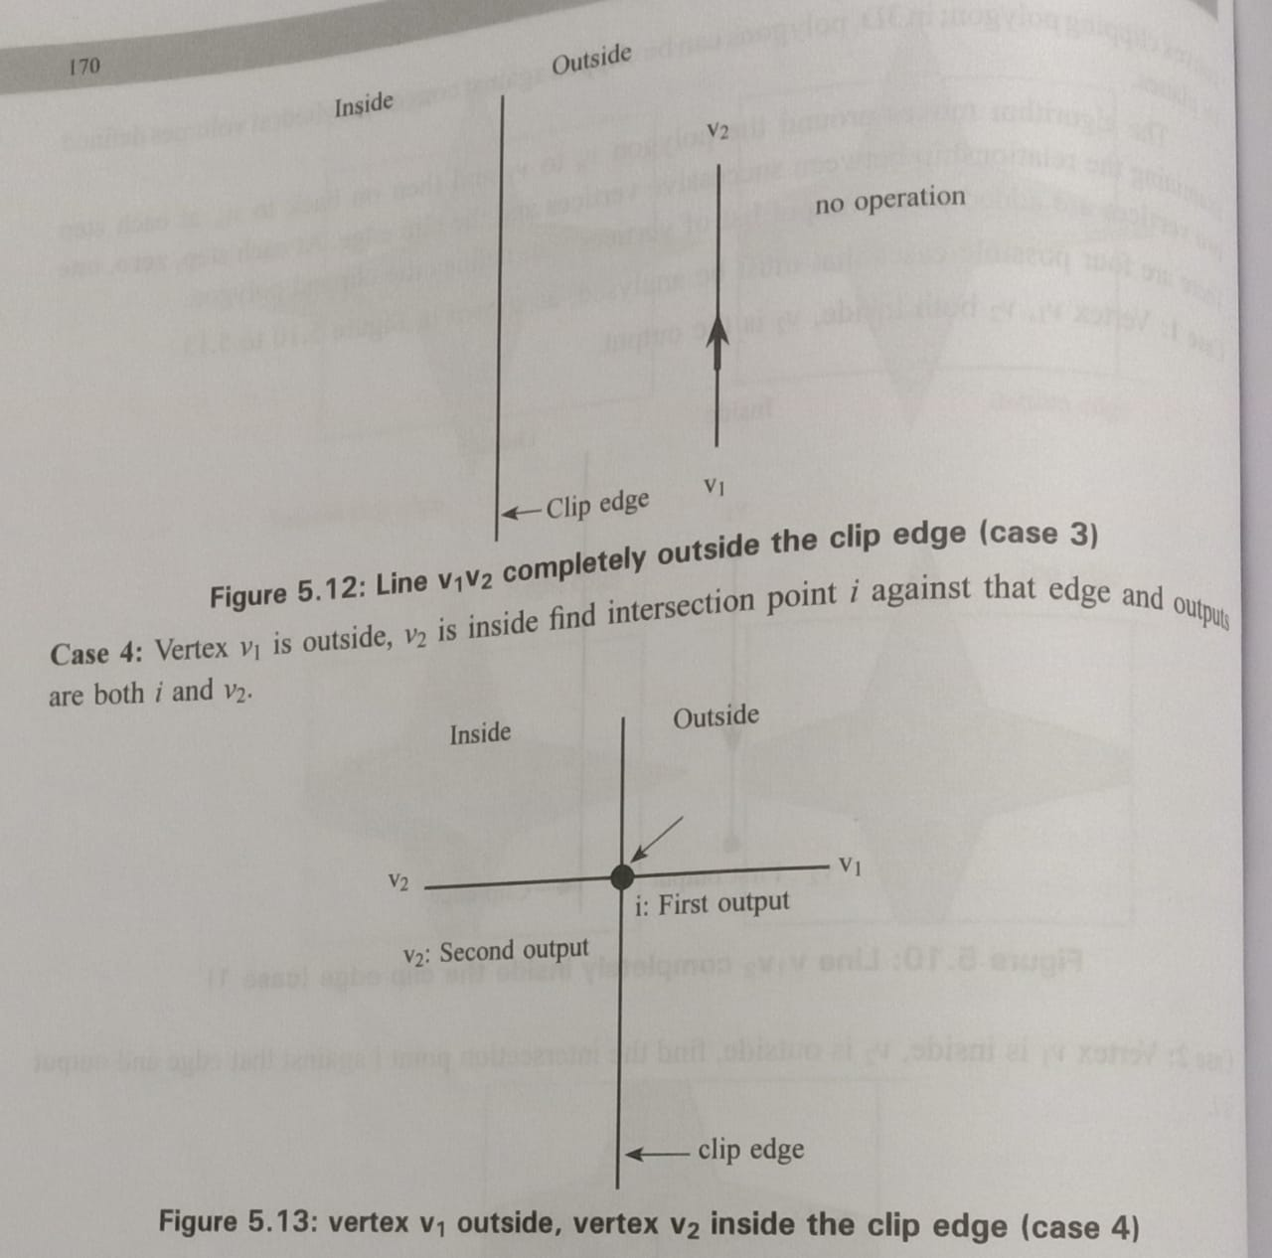

Slide 18
Algorithm
Read coordinates of all vertices of the polygon.
Read coordinates of the clipping window
Consider the left edge of the window
Compare the vertices of each edge of the polygon, individually with the clipping plane
Save the resulting intersections and vertices in the new list of vertices according to four possible relationships between the edge and the clipping boundary discussed earlier.
Repeat the steps 4 and 5 for remaining edges of the clipping window. Each time the resultant list of vertices is successively passed to process the next edge of the clipping window.
Stop.

Slide 19
Advantages and Disadvantages
Advantages :
Versatility: Can clip any type of convex or concave polygon against an arbitrary convex clipping region.
Geometric Accuracy: Preserves the shape and topology of the original polygon during clipping.
Efficiency: Operates in linear time complexity with respect to the number of vertices.
Handles Multiple Clipping Regions: Can handle multiple clipping regions sequentially.
Disadvantages :
Degenerate Cases: Susceptible to issues with polygons entirely outside or with edges parallel to clipping boundaries.
Concave Polygons: Requires polygon decomposition into convex sub-polygons for concave cases.
Processing Order: Result can be affected by the order in which vertices are processed.
Inefficiency for Convex Polygons: May not offer significant advantages over simpler methods for convex polygons.

Slide 20
Applications
Computer-aided design (CAD): It is employed in CAD systems for accurate polygon clipping against specified regions or boundaries, ensuring precise representation and visualization of complex shapes.
GIS (Geographic Information Systems): The algorithm is used for clipping and displaying map features within defined areas, enabling efficient visualization of geographical data.
Polygon-based simulations: It finds applications in simulations involving polygonal entities, such as physics simulations, architectural modeling, or virtual environments
Image processing: It finds applications in image processing tasks where polygonal regions need to be clipped against a specified area, enabling precise extraction or manipulation of image regions.

Slide 21
THANK YOU

